Slide 1
Paper name : Pixel Recurrent Neural Networks
011143085 (Md. Abid Hossain)
011161164 (Md. Rifat Alvi Habib)
011161163 (Suparna Shil)
011161123(Monowar Perves)
011161121(Md.Tanvir Islam)
011161040 (Sadia Islam)

Slide 2
Model
The aim is to estimate a distribution over natural images that can be used to tractably compute the likelihood of images and to generate new ones.
The network scans the image one row at a time and one pixel at a time within each row.
To capture the generation process, this paper propose to use a two-dimensional LSTM network.

Slide 3
How it Generates pixel
To estimate the joint distribution p(x) they used the product of the conditional distributions over the pixels.
Each pixel (Xi) is in turn jointly determined by three values, one for each of the color channels Red, Green and Blue (RGB).
Each of the colors is thus conditioned on the other channels as well as on all the previously generated pixels
During training and evaluation the distributions over the pixel values are computed in parallel, while the generation of an image is sequential.

Slide 4
Pixel Recurrent Neural Networks with LSTM
Row LSTM
The Row LSTM is a unidirectional layer that processes the image row by row from top to bottom computing features for a whole row at once
Diagonal BiLSTM
The Diagonal BiLSTM is designed to both parallelize the computation and to capture the entire available context for any image size. Each of the two directions of the layer scans the image in a diagonal fashion starting from a corner at the top and reaching the opposite corner at the bottom.

Slide 5
Overview
Presented a deep neural network that sequentially predicts the pixels in an image along the two spatial dimensions.
The method described in the paper models the discrete probability of the raw pixel values and encodes the complete set of dependencies in the image.
Two types of LSTM layers are used which uses convolutions to compute at once the states along one of the spatial dimensions.
The models were tested on the CIFAR-10 dataset.

Slide 6
Long short-term memory(LSTM)
Long short-term memory is an artificial recurrent neural network architecture used in the field of deep learning. Unlike standard feedforward neural networks, LSTM has feedback connections. It can not only process single data points, but also entire sequences of data

Slide 7
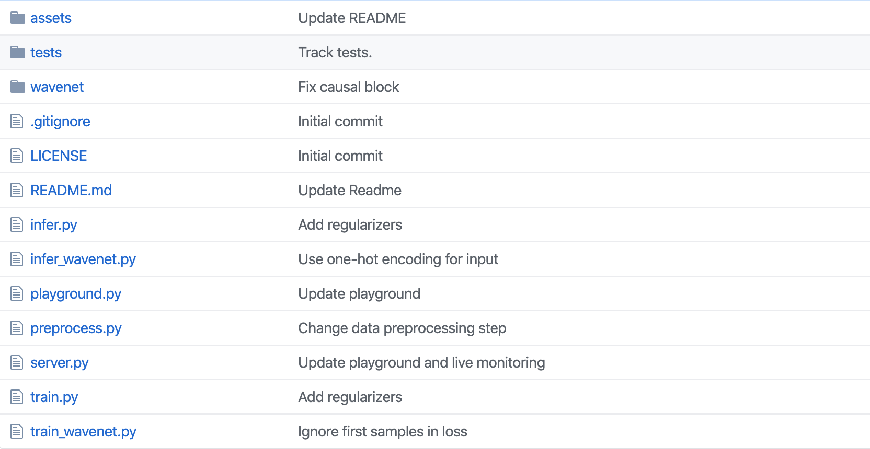
Github Code link
https://github.com/rampage644/wavenet

Slide 8
Github link
https://github.com/mdabhn/pixel-recurrent-neural-networks

